Slide 1
Rookery
Academy of Interactive Entertainment
Story
Tower defence game
Visual style
Markets
Production

Slide 2
Story
Mother dragon defending her hoard (which she uses to raise her children) and herself from hordes of avaricious adventurers
Unusual and innovative perspective, from the side of gaming's usual enemy
Female, matronly main character can bring in soccer mom demographic

Slide 3
Tower Defence
Hits a market niche that is currently contested
While Plants vs. Zombies is a winner for PC markets, there is no clear tower defence game for mobile, so it is possible to make a mark therein

Slide 4
Visual Style
Viking, medieval fantasy style
Cute, cartoony characters and icons stand out on more realistic environments
Allows us to keep to relatively lo-fi standards without sacrificing visual detail

Slide 5

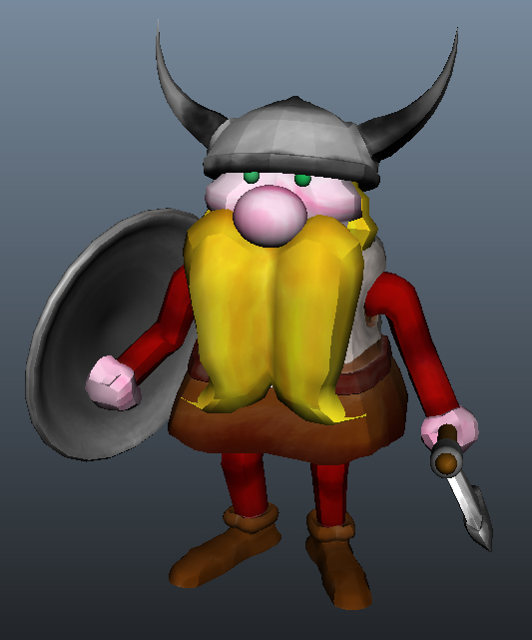
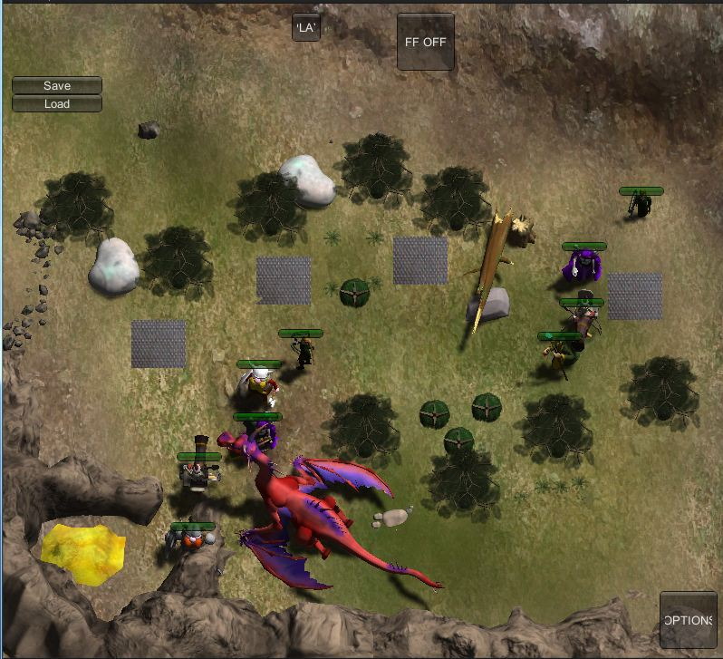
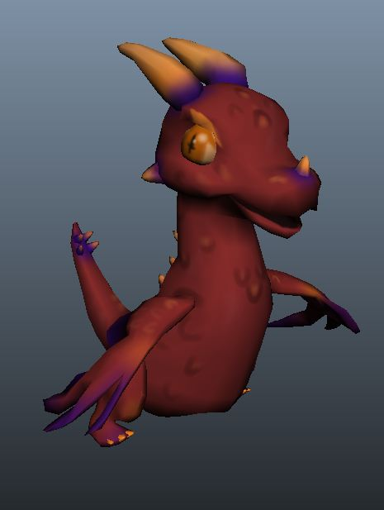

Visual Style WIPs

Slide 6
Markets
A mobile market is easy for students to develop for and break into
Steam Greenlight would also be a good way to promote our game, besides being a great way to get users
From there, the world!

Slide 7
Production
Due at the end of May
Working in Unity, using Hansoft for scrum and Perforce for version control
Programmers and artists work three days a week
Burn is only the cost of tuition. Whatever happens, for better or worse, we gain a great learning experience!

